Slide 1


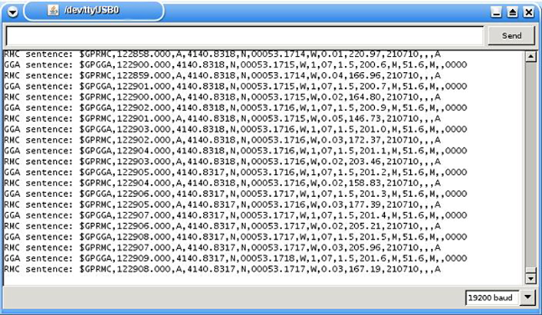
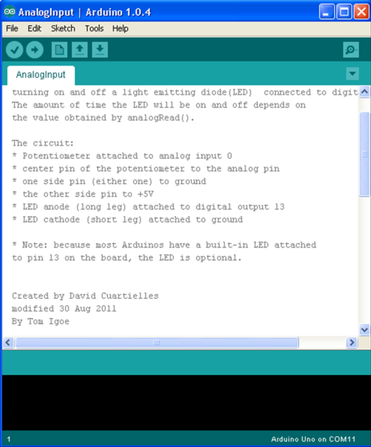
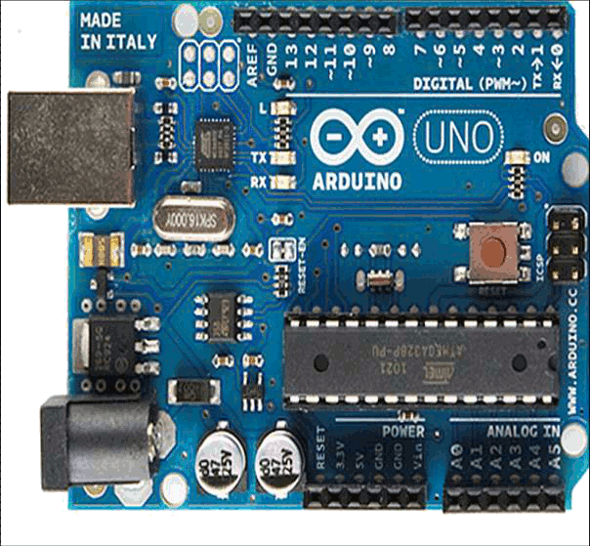
First steps with Arduino
Ok, how do I start?
C/C++

Slide 2

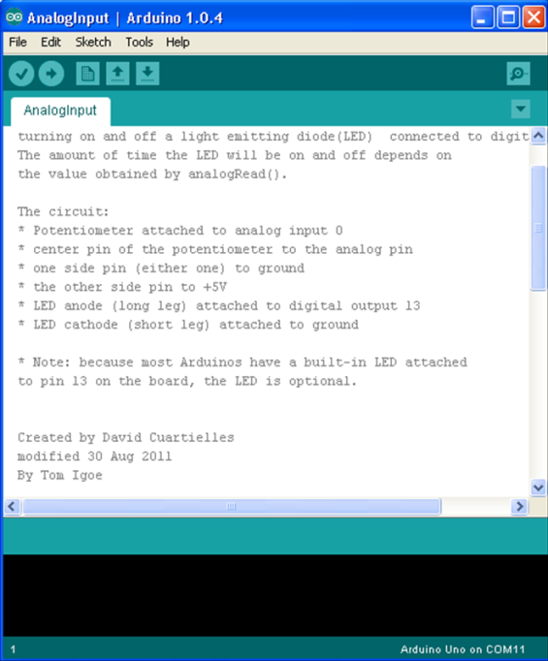

Getting started with Arduino
Program installation
Making Arduino talk to your computer
The Arduino development environment

Slide 3
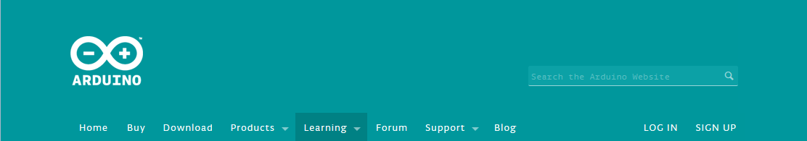
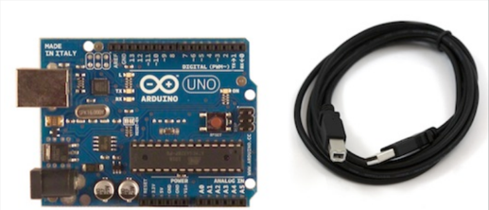
http://arduino.cc/en/Guide/HomePage
Getting started:
Download the Arduino environment from:
http://arduino.cc/en/Main/Software
Install the downloaded file
Connecting Arduino to your computer
Install drivers (only if windows requires intervention)
Connected to the computer; a ‘COM’ port; up to 8 Arduino boards simultaneously.

Slide 4
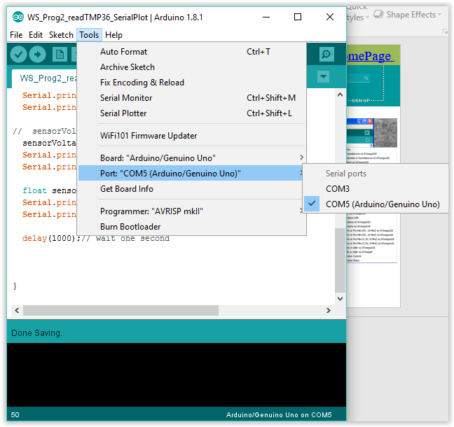

http://arduino.cc/en/Guide/HomePage
Arduino IDE:
Launch the application
Select board type and COM#
Load an example file
Upload it to the Arduino board

Slide 5
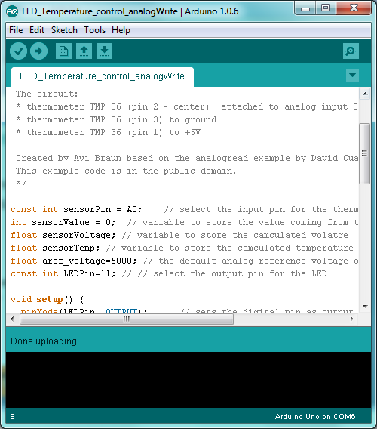
The Arduino development environment
http://arduino.cc/en/Guide/Environment
Toolbar
Text editor – edit the Sketch
Massage Box – compiling, uploading, and errors messages
Toolbar
Next slide
Other Information:
Line number; board type and COM#
Sketch name; IDE version
text editor
Massage Box

Slide 6

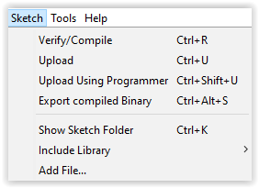
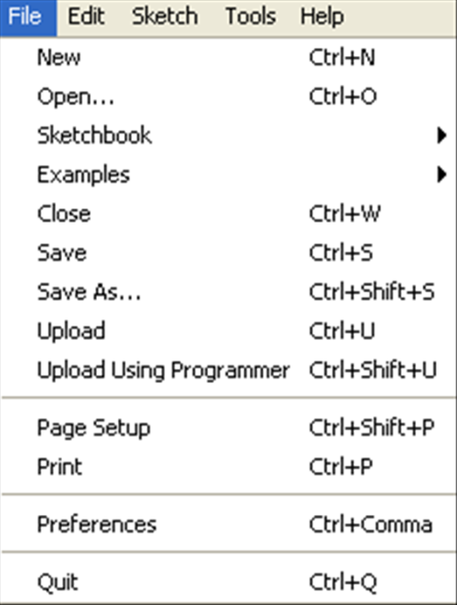
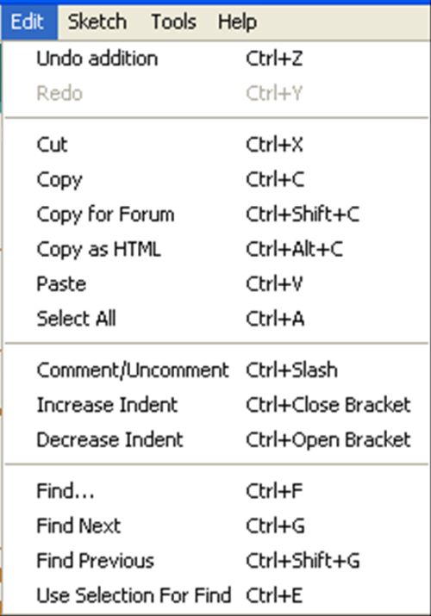
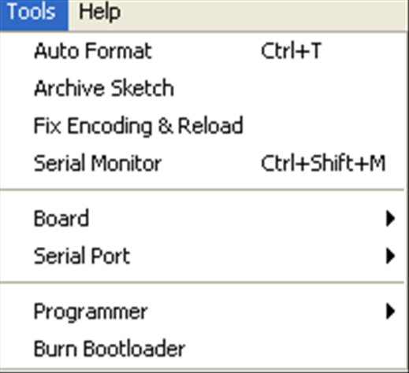
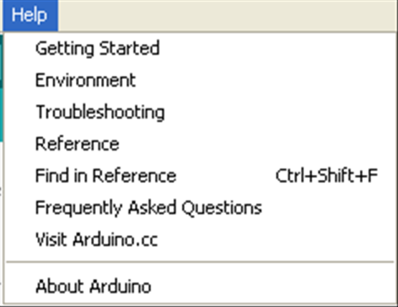
The Arduino development environment
http://arduino.cc/en/Guide/Environment
Serial monitor
Verify Upload New Open Save

Slide 7
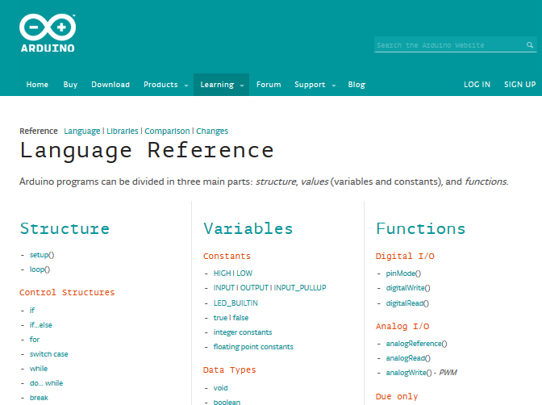
Programming Learning tools
http://arduino.cc/en/Tutorial/HomePage
http://arduino.cc/en/Reference/HomePage
Start with example
Use the reference to understand the code

Slide 8
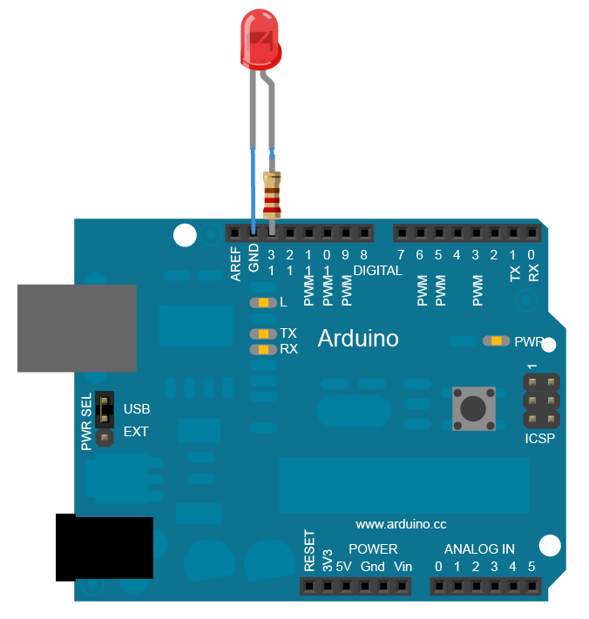
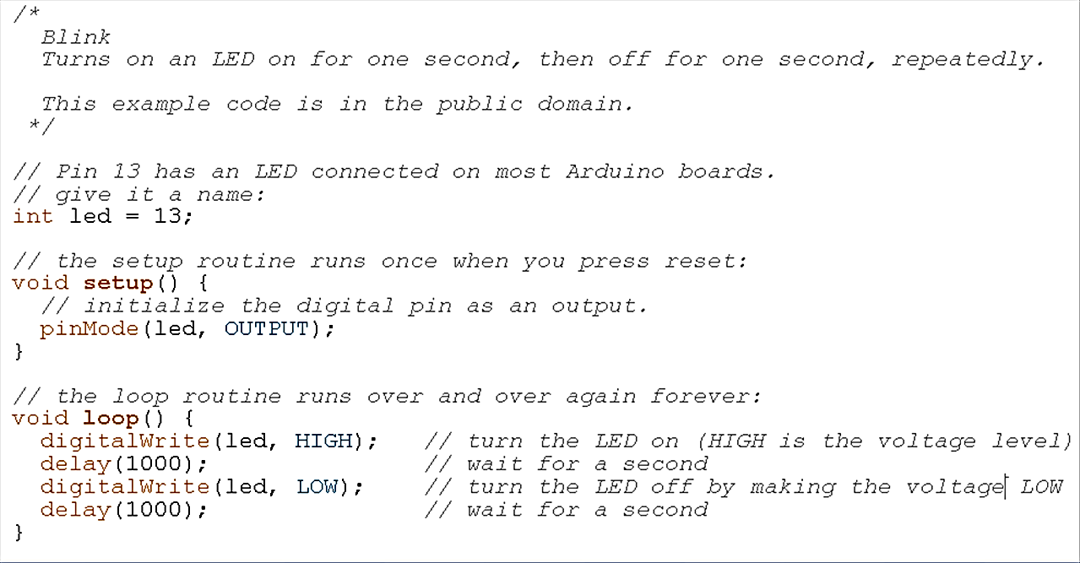
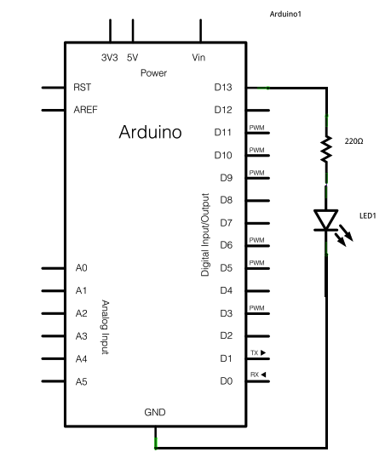
Programing
Blink example
Code:
Introductive Comments
D13
Declaration of global variables
220 ohm
Setup function
LED
Loop function
GND
Notes:
delayMicroseconds()
Minimal is 3 microseconds%

Slide 9
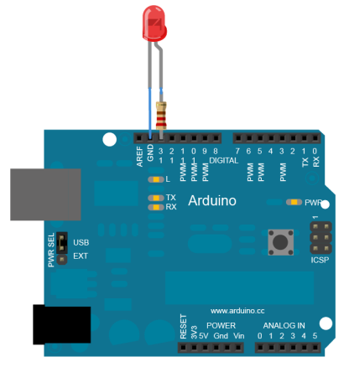
Programing
/* Blink Turns on an LED on for one second, then off for one second, repeatedly. This example code is in the public domain. */ // Pin 13 has an LED connected on most Arduino boards.
// give it a name: int led = 13;
// the setup routine runs once when you press reset: void setup() { pinMode(led, OUTPUT); // initialize the digital pin as an output. } // the loop routine runs over and over again forever: void loop() { digitalWrite(led, HIGH); // turn the LED on (HIGH is the voltage level) delay(1000); // wait for a second digitalWrite(led, LOW); // turn the LED off by making the voltage LOW delay(1000); // wait for a second }
D13
GND
delayMicroseconds()

Slide 10
10 minutes hands-on
Connect Arduino to the computer
Open the IDE
Upload the blink program
Change the blink frequency to 2Hz

Slide 11
Programing
http://arduino.cc/en/Tutorial/HomePage
http://arduino.cc/en/Reference/HomePage
Arduino ‘knows’ how to compile C and C++ to AVR
(AVR = C for Atmel chips)
Variables require declaration
Scope: Global, local, Const., Static variables
Any variable declared outside of a function is Global
All others are local unless defines as ‘static’.
Notes:
A global variable is one that can be seen by every function in a program. Local variables are only visible to the function in which they are declared. In the Arduino environment, any variable declared outside of a function (e.g. setup(), loop(), etc. ), is a global variable.

Slide 12
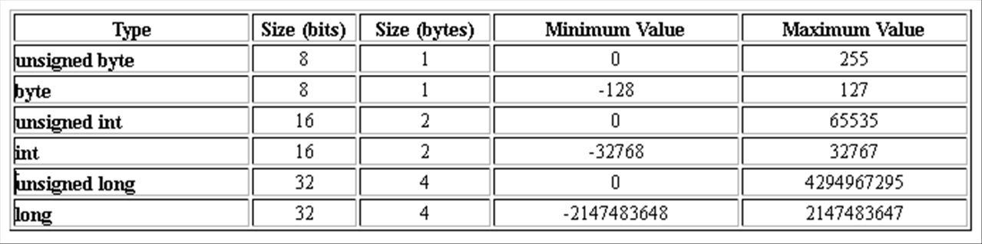
Programing
http://arduino.cc/en/Tutorial/HomePage
http://arduino.cc/en/Reference/HomePage
Data types:
int speed =400;
long speedOfLight = 186000;
Rollover :
Int Rollover=32767;
Rollover= Rollover+1;
Rollover now equals -32768
Notes:
AVR Code
The Arduino environment is based on Atmel Atmega microcontrollers. The AVR language is a "C" environment for programming Atmel chips. Much of the Arduino language is written with AVR constants and functions and there are many things that are still not easy to accomplish with the Arduino language without using some AVR code.
The good news is that because the Arduino environment uses GCC to compile code, all of the port and register variables found in the Atmega 168 datasheet and tutorials on AVR code assembly language are supported when using the Arduino IDE.
This page is an attempt to document the most useful AVR functions and code snippets.

Slide 13
Programing
http://arduino.cc/en/Tutorial/HomePage
http://arduino.cc/en/Reference/HomePage
Other data types:
char: character value char LetterA=‘a’;
float : ±3.4028235E+38; 32bits; 6-7 decimal digits of precision
double: same as float (in Uno)
Strings:
char array: char Str[ ] = "arduino";
Using the ‘String’ library: String text1 =“this is a string”;
int myPins[] = {2, 4, 8, 3, 6};
X=myPins[2];
Notes:
AVR Code
The Arduino environment is based on Atmel Atmega microcontrollers. The AVR language is a "C" environment for programming Atmel chips. Much of the Arduino language is written with AVR constants and functions and there are many things that are still not easy to accomplish with the Arduino language without using some AVR code.
The good news is that because the Arduino environment uses GCC to compile code, all of the port and register variables found in the Atmega 168 datasheet and tutorials on AVR code assembly language are supported when using the Arduino IDE.
This page is an attempt to document the most useful AVR functions and code snippets.

Slide 14
Control Structures (if, while, etc.)
http://arduino.cc/en/Reference/If
If (someVariable>50)
{
//do something here;
}
For example:
for (int i=1; i<4;i++)
{
Serial.println(i)
}
x==y
x!=y
X<y
X>y
X<=y
X>=y
while
for
switch/case
do-while
break
return

Slide 15
Mathematical operations
https://www.arduino.cc/en/Reference/Arithmetic
https://www.arduino.cc/en/Reference/HomePage
i=i+1; i++; i+=1
9/4=2;
Modulus: 22%10=2
Abs(-1)=1
min(1,2)=1 (similar for ‘max’)
pow(2,3)=8; sqrt(9)=3
sin(rad); cos(); tan()
sensVal = constrain(sensVal, 10, 150); // limits range of sensor values to between 10 and 150
val = map(val, 0, 1023, 0, 255);
floor;ceil;
PI;RAD_TO_DEG;
random(min,max);
Notes:
long map(long x, long in_min, long in_max, long out_min, long out_max) { return (x - in_min) * (out_max - out_min) / (in_max - in_min) + out_min; }

Slide 16
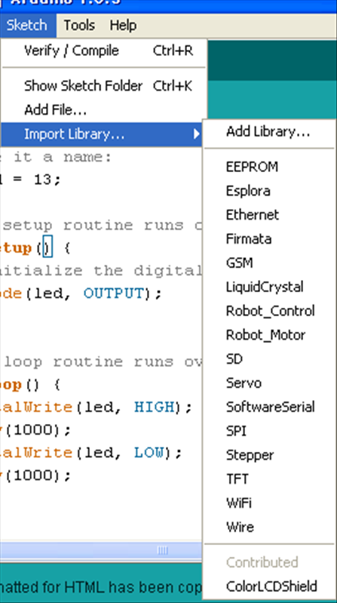
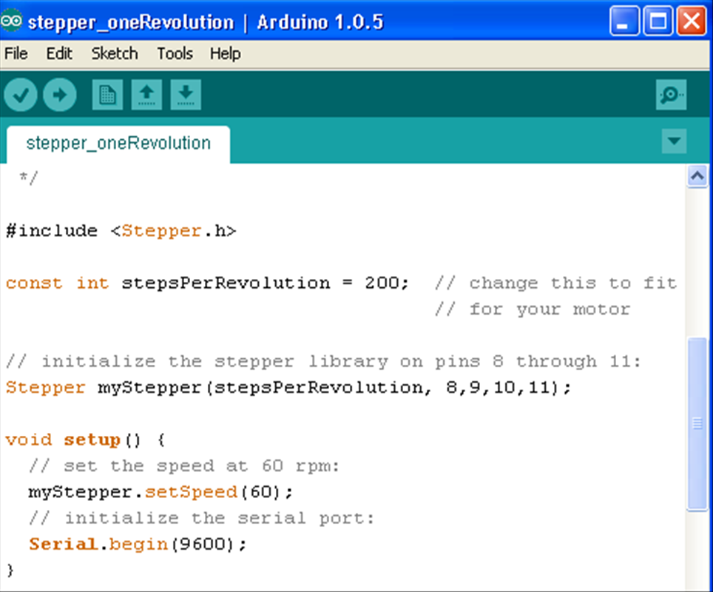
Libraries
http://arduino.cc/en/Guide/Libraries
Collection of code lines
Built-in libraries
Others – require installation and to be called at the beginning of the code:
Import library: > #include <Stepper.h>
Notes:
Libraries are a collection of code that makes it easy for you to connect to a sensor, display, module, etc. For example, the built-in LiquidCrystal library makes it easy to talk to character LCD displays. There are hundreds of additional libraries available on the Internet for download. The built-in libraries and some of these additional libraries are listed in the reference. To use the additional libraries, you will need to install them.

Slide 17
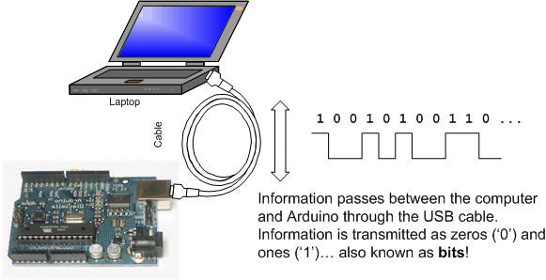
Serial library
communication between the Arduino board and other deivces (PC over the USB port. Serial sensors) using the serial communication protocol.
Serial.begin(9600);
9600 Bits Per Second (baud rate)
(some) Important procedures:
begin()
available()
print()
println()
read()
http://www.ladyada.net/learn/arduino/lesson4.html
See the ‘AnalogReadSerial’ example unber the ‘basic’ category
Notes:
Libraries are a collection of code that makes it easy for you to connect to a sensor, display, module, etc. For example, the built-in LiquidCrystal library makes it easy to talk to character LCD displays. There are hundreds of additional libraries available on the Internet for download. The built-in libraries and some of these additional libraries are listed in the reference. To use the additional libraries, you will need to install them.

Slide 18
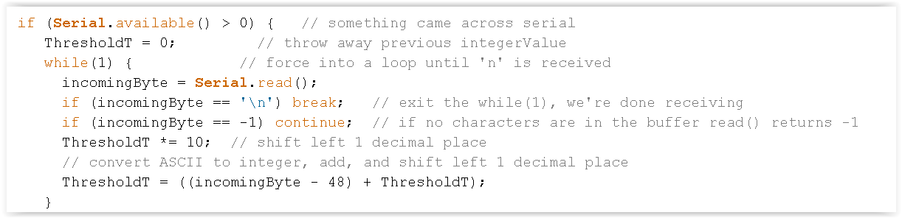

Slide 19
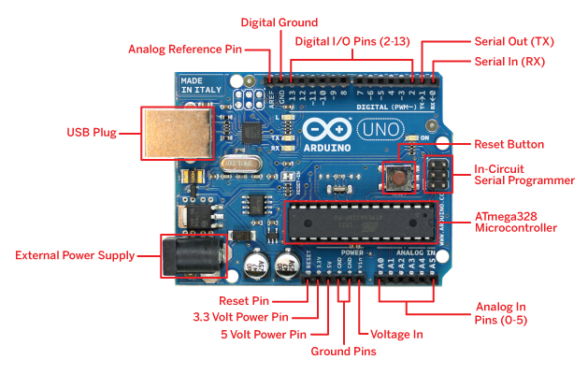
Rx and Tx LEDs
Integrated LEDs:
Pin13
TX
RX
Serial communication
7-12V
10 bits
I2C (Inter-Integrated Circuit) and SPI (Serial Peripheral Interface)

Slide 20
Sensors types
Digital (1 or 0, True or False, High or Low):
Analog: (returning value between 0 and 1023)
Pulse width (e.g. Distance PING)
Serial
Synchronous protocols (I2C, SPI)

Slide 21
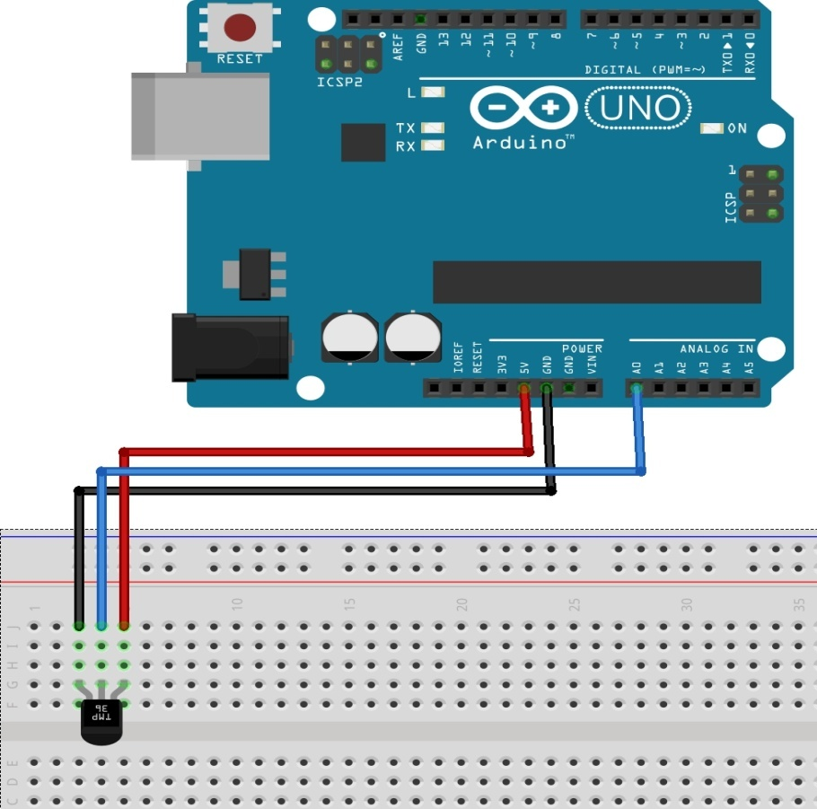
Hands-on #2 Reading an analog sensor (TMP 36)
Safety notes:
Do not short-circuit the I/O pins (Gnd to voltage sources)
Connect devices in the correct polarity
analogRead; Serial.print; delay; Serial.println; if, else logical conditions; Serial.begin

Slide 22
Hands-on #2 Reading an analog sensor (TMP 36)
analogRead; Serial.print; delay; Serial.println; if, else logical conditions; Serial.begin

Slide 23
Program structure
Define variables
Establish Serial connection (in the void setup() )
1.Read analog value:
Loop: read - sensorValue = analogRead(sensorPin);
Loop: print - Serial.println(sensorValue);
Use example named: Basic → readAnalogeVoltage
2. Convert the ‘analog reading’ to voltage:
sensorVoltage=map(sensorValue,0,1023,0,5000);
3. Convert the ‘voltage’ to T(C):
float sensorTemp =25+(sensorVoltage-750)*.1

Slide 24
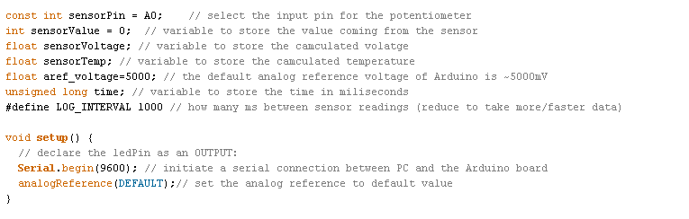

Slide 25
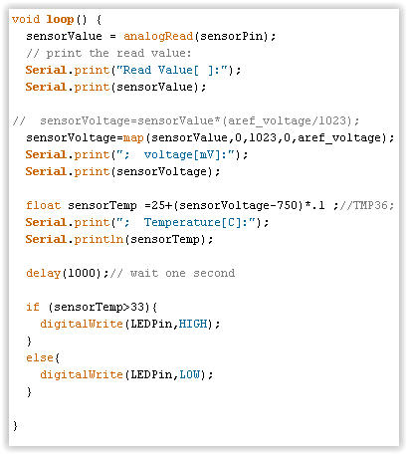

Slide 26
For more that one variable
Plotting the temperature over time:
Print lines with the variable(s) you want to plot:
Serial.print(sensorTemp2);
Serial.print(“ “);
Serial.println(sensorTemp2);

Slide 27
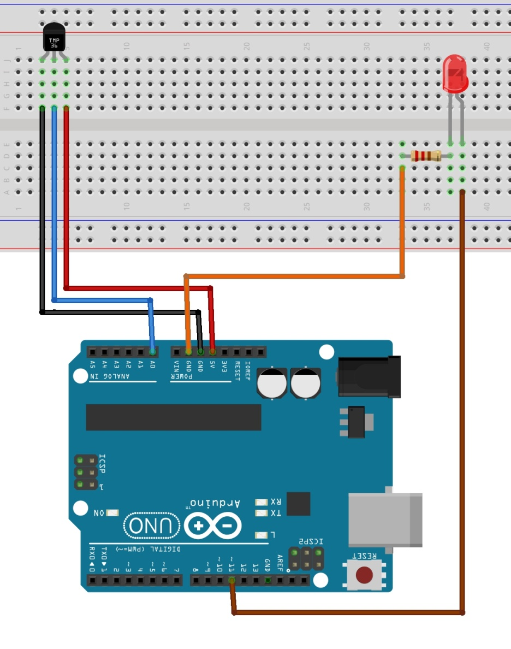
Hands-on #3 Reading an analog sensor (TMP 36) and controlling LED
analogRead;
Serial.print; delay; Serial.println; if, else logical conditions; Serial.begin
digitalWrite
analogWrite
LED: short leg to GND via (150-220Ohm) Resistor

Slide 28
Program structure:
As before +
if (sensorTemp>25){
digitalWrite(LEDPin,HIGH);
}
else{
digitalWrite(LEDPin,LOW);
}
Use example named: Control→ IfStatementConditional

Slide 29
Summary
Getting started with Arduino
Program installation and making Arduino talk to your computer
The Arduino development environment
Libraries
What are they good for?
Installation
Programming

Slide 30
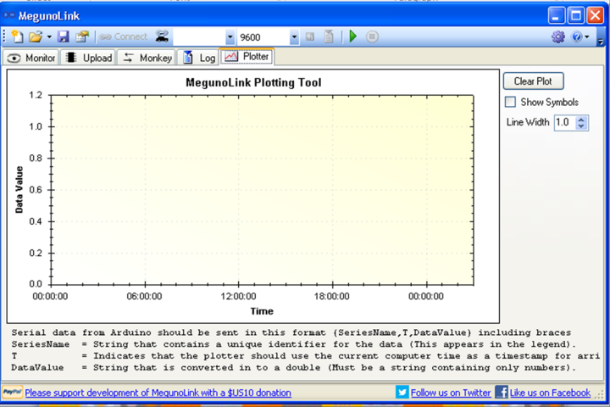
First steps with Arduino
“OK, how do I start?”
?
C/C++

